Slide 1
NextHikes Bike Rentals Analysis Report 2026
Prepared By : Suresh Kumar

Slide 2
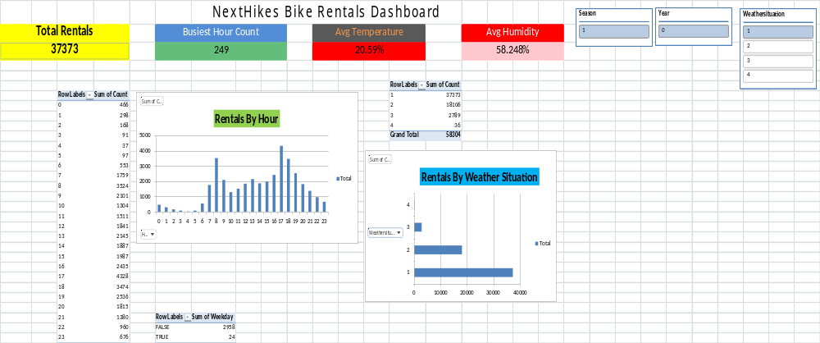

Slide 3
